Slide 1

CSE- 321
Software Engineering
Lecture :21 Software Cost Estimation
Fahad Ahmed
Lecturer, Dept. of CSE
E-mail: fahadahmed@uap-bd.edu

Slide 2


Software Cost Estimation

Slide 3
Software Cost Estimation
Estimation is the process of finding an estimate, or approximation, which is a value that can be used for some purpose even if input data may be incomplete, uncertain, or unstable.
Estimation determines how much money, effort, resources, and time it will take to build a specific system or product.
Estimation is based on −
Past Data/Past Experience
Available Documents/Knowledge
Assumptions
Identified Risks

Slide 4
Software Cost Estimation
Fundamental estimation questions
How much effort is required to complete an activity?
How much calendar time is needed to complete an activity?
What is the total cost of an activity?
Project estimation and scheduling and interleaved management activities

Slide 5
Software Cost Estimation
Software Cost Estimation
For any new software project, it is necessary to know how much it will cost to develop and how much development time will it take. These estimates are needed before development is initiated, but how is this done?
Several estimation procedures have been developed and are having the following attributes in common.
Project scope must be established in advanced.
Software metrics are used as a support from which evaluation is made.
The project is broken into small PCs which are estimated individually. To achieve true cost & schedule estimate, several option arise.
Delay estimation
Used symbol decomposition techniques to generate project cost and schedule estimates.
Acquire one or more automated estimation tools.

Slide 6
Software cost components
Software cost components
Hardware and software costs
Travel and training costs
Effort costs (the dominant factor in most projects)
salaries of engineers involved in the project
Social and insurance costs
This following costs are all part of the total effort cost:
Costs of providing, heating and lighting office space
Costs of support staff such as accountants, administrators, system managers, cleaners and technicians
Costs of networking and communications
Costs of central facilities such as a library or recreational facilities
Costs of Social Security and employee benefits such as pensions and health insurance.

Slide 7
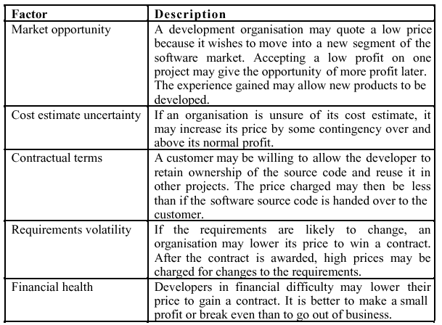
Factors that affecting software pricing

Slide 8
Estimation techniques
There is no simple way to make an accurate estimate of the effort required to develop a software system
Initial estimates are based on inadequate information in a user requirements definition
The software may run on unfamiliar computers or use new technology
The people in the project may be unknown
Project cost estimates may be self-fulfilling
The estimate defines the budget and the product is adjusted to meet the budget
Estimation techniques
Algorithmic cost modelling
Expert judgement
Estimation by analogy
Parkinson's Law
Pricing to win

Slide 9
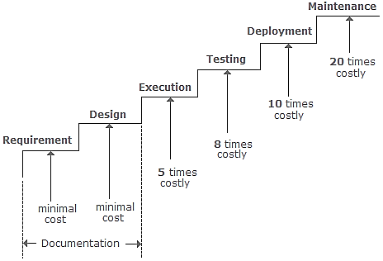
Estimation techniques
A defect, which could have been removed during the initial stage, is removed in a later stage. How does this affect the cost?

Slide 10
COCOMO model

Slide 11
LOC: Lines of Code
Function Point
Cost Estimation
COCOMO I
Basic COCOMO
Intermediate COCOMO
Detailed COCOMO
COCOMO II

Slide 12
LINES OF CODE (LOC)
Lines of code(LOC) or Source lines of code (SLOC )is a software metric used to measure the size of a software program by counting the number of lines in the text of the program's source code.
LOC is typically used to predict the amount of effort that will be required to develop a program, as well as to estimate programming productivity or effort once the software is produced.

Slide 13
FUNCTION POINT
A Function Point (FP) is a unit of measurement to express the amount of business functionality, an information system (as a product) provides to a user. FPs measure software size. They are widely accepted as an industry standard for functional sizing.

Slide 14
Constructive Cost Model(COCOMO )
The COCOMO model is an algorithmic software cost estimation model developed by Barry Boehm in 1981.
The model uses a basic regression formula, with parameters that are derived from historical project data and current project characteristics.
The COCOMO estimates the cost for software product development in terms of effort (resources required to complete the project work) and schedule (time required to complete the project work) based on the size of the software product.
It estimates the required number of Man-Months (MM) for the full development of software products

Slide 15
Constructive Cost Model(COCOMO )
COCOMO model are categorized into three types:
Basic COCOMO
Intermediate COCOMO
Detailed COCOMO
According to COCOMO, there are three modes of software development projects that depend on complexity.
Such as:
1. Organic Project
2. Semidetached Project
3. Embedded Project
.

Slide 16
Development Mode of S/W Projects
Mode | Project Size | Nature of Project | Innovation | Deadline
Organic | Typically 2-50 KLOC | Small size project, Experienced developers. | Little | Not Tight
Semi Detached | Typically 50-300KLOC | Medium size project and team. | Medium | Medium
Embedded | Typically over 300KLOC | Large project, Real-time systems | Significant | Tight
KLOC is a measure of the size of a computer program. The size is determined by measuring the number of lines of source code a program has.

Slide 17
Constructive Cost Model(COCOMO )
1. Organic Project
It belongs to small & simple software projects which are handled by a small team with good domain knowledge and few rigid requirements.
Example: Small data processing or Inventory management system.
2. Semidetached Project
It is an intermediate (in terms of size and complexity) project, where the team having mixed experience (both experience & inexperience resources) to deals with rigid/nonrigid requirements.
Example: Database design or OS development.
3. Embedded Project
This project having a high level of complexity with a large team size by considering all sets of parameters (software, hardware and operational).
Example: Banking software or Traffic light control software.

Slide 18
Basic COCOMO Model
The Basic COCOMO
It is the one type of static model to estimates software development effort quickly and roughly. It mainly deals with the number of lines of code and the level of estimation accuracy is less as we don’t consider the all parameters belongs to the project. The estimated effort and scheduled time for the project are given by the relation:
Effort (E) = a*(KLOC)^{b} MM
Scheduled Time (D) = c*(E)^{d} Months(M)

Slide 19
Basic COCOMO Model
Where,
E = Total effort required for the project in Man-Months (MM).
D = Total time required for project development in Months (M).
KLOC = the size of the code for the project in Kilo lines of code.
a, b, c, d = The constant parameters for a software project.
PROJECT TYPE | a | b | c | d
Organic | 2.4 | 1.05 | 2.5 | 0.38
Semidetached | 3 | 1.12 | 2.5 | 0.35
Embedded | 3.6 | 1.2 | 2.5 | 0.32

Slide 20
Basic cocomo: Example-1
Example: For a given project was estimated with a size of 300 KLOC. Calculate the Effort, Scheduled time for development. Also, calculate the Average resource size and Productivity of the software for Organic project type.
Ans: Given estimated size of project is: 300 KLOC
For Organic
Effort (E) = a*(KLOC)^{b} = 2.4*(300)^{1.05} = 957.61 MM
Scheduled Time (D) = c*(E)^{d} = 2.5*(957.61)^{0.38} = 33.95 Months(M)
Avg. Resource Size = E/D = 957.61/33.95 = 28.21 Mans
Productivity of Software = KLOC/E = 300/957.61 = 0.3132 KLOC/MM = 313 LOC/MM

Slide 21
Basic cocomo: Example-1
Example: For a given project was estimated with a size of 300 KLOC. Calculate the Effort, Scheduled time for development. Also, calculate the Average resource size and Productivity of the software for Organic project type.
Ans: Given estimated size of project is: 300 KLOC
For Semidetached
Effort (E) = a*(KLOC)^{b} = 3.0*(300)^{1.12} = 1784.42 MM Scheduled Time (D) = c*(E)^{d} = 2.5*(1784.42)^{0.35} = 34.35 Months(M)
For Embedded
Effort (E) = a*(KLOC)^{b} = 3.6*(300)^{1.2} = 3379.46 MM Scheduled Time (D) = c*(E)^{d} = 2.5*(3379.46)^{0.32} = 33.66 Months(M)

Slide 22
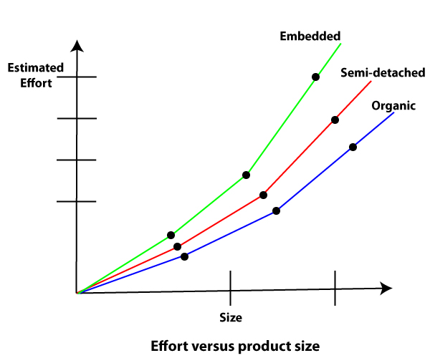
development time versus the product size
https://www.javatpoint.com/cocomo-model

Slide 23
Basic cocomo: Example-2
Example: A project size of 200KLOC is to be developed. S/W development team has average experience on similar type of projects. The project schedule is not very tight. Calculate the effort and development time of the project.
Ans: 200 KLOC implies semi-detached mode.
Hence,
E= 3.0 * (200)^{1.12} = 1133.12 MM
D=2.5 * (1133.12)^{0.35} = 29.3 M
Avg. staff size(SS) = E/D = 1133.12/29.3=38.67 Persons.
Productivity (P) = KLOC/E = 200/1133.12=0.1765 KLOC/MM.

Slide 24
Intermediate COCOMO
The intermediate model estimates software development effort in terms of size of the program and other related cost drivers parameters (product parameter, hardware parameter, resource parameter, and project parameter) of the project.

Slide 25
Intermediate COCOMO
Extension of Basic COCOMO
Why Use ?
Basic model lacks accuracy
Computes software development effort as a function of program size and set of 15 Cost Drivers
Cost Driver: A multiplicative factor that determines the effort required to complete the software project.
Why Cost Drivers?
Adjust the nominal cost of a project to the actual project Environment.
For each Characteristics, Estimator decides the scale factor
Very Low
Low
Nominal
High
Very High
Extra High

Slide 26
Cost Drivers
Product Attributes
Required Software Reliability (RELY)
Personnel Attributes
Analyst Capability (ACAP)
Application Experience (AEXP)
Database Size (DATA)
Project Attributes
Modern programming practices (MODP)
Use of Software tools (TOOL)
Computer turnaround time (TURN)
Execution Time Constraint (TIME)
Computer Attributes
Product Complexity (CPLX)
Main Storage constraint (STOR)
Virtual Machine volatility (VIRT)
Programmer Capability (PCAP)
Virtual Machine Experience (VEXP)
Programming language Experience (LEXP)
Required development schedule (SCED)

Slide 27
The Calculation
Multiply all 15 Cost Drivers to get Effort Adjustment Factor(EAF)
E(Effort) = a(KLOC)^{b} * EAF(in Person-Month)
D(Development Time) = c(E)^{d} (in month)
SS (Avg Staff Size) = E/D (in persons)
P (Productivity) = KLOC/E (in KLOC/Person-month)
Project | a | b | c | d
Organic | 3.2 | 1.05 | 2.5 | 0.38
Semidetached | 3.0 | 1.12 | 2.5 | 0.35
Embedded | 2.8 | 1.20 | 2.5 | 0.32

Slide 28
Intermediate COCOMO : Example
A new project with estimated 400 KLOC embedded system has to be developed. Project manager hires developers of very low quality but a lot of experience in programming language. Calculate the Effort, Development time, Staff size & Productivity.
EAF = 1.29 * 0.95 = 1.225
400 LOC implies Embedded System
Effort = 2.8*(400)^{1.20} * 1.225 = 3712 * 1.22 = 4528 person-months
Development Time = 2.5 * (4528)^{0.32} = 2.5 * 14.78 = 36.9 months
Avg. Staff Size = E/D = 4528/36.9 = 122 persons
Productivity = KLOC/Effort = 400/4528 = 0.0884 KLOC/person-month
Cost Drivers | Very Low | Low | Nominal | High | Very High | Extra High
AEXP | 1.29 | 1.13 | 1.00 | 0.91 | 0.82 | --
LEXP | 1.14 | 1.07 | 1.00 | 0.95 | -- | --
Project | a | b | c | d
Embedded | 2.8 | 1.20 | 2.5 | 0.32

Slide 29
Detailed COCOMO
Detailed COCOMO =
Intermediate COCOMO + assessment of Cost Drivers impact on each phase.
Phases
Plans and requirements
System Design
Detailed Design
Module code and test
Integrate and test
Cost of each subsystem is estimated separately. This reduces the margin of error.

Slide 30
Advantages and Disadvantages of COCOMO Model
Advantages
Easy to estimate the total cost of the project.
Easy to implement with various factors.
Provide ideas about historical projects.
Disadvantages
It ignores requirements, customer skills, and hardware issues.
It limits the accuracy of the software costs.
It mostly depends on time factors.

Slide 31
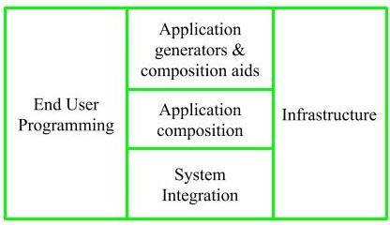
WHY COCOMO-II ?
The changes in s/w development techniques included a move away from mainframe overnight batch processing to desktop-based real-time turnaround.
These changes and others began to make applying the original COCOMO model problematic.
The model is tuned to the life cycle practices of the 21st century.
COCOMO-II is the revised version of the original cocomo (Constructive Cost Model) and is developed at University of Southern California. It is the model that allows one to estimate the cost, effort and schedule when planning a new software development activity.
It consists of three sub-models:
Stages Of Cocomo-II
Application Composition
Earlier Design
Post Architecture

Slide 32
Final Word
“The models are just there to help, not to make the management decisions for you.”
--Barry Boehm

Slide 33

Are you a software Engineer ?

Slide 34

Thanks to All

